Slide 1
ECE 222 Lab 3:
Hardware Interfacing
TA: Conor O’Sullivan
Instructor: Prof. A. Hasan

Slide 2
Outline
Objectives
Lab 3 Requirements:
  Serial Port Interface (Keyboard)
  Parallel Port Interface (Keypad)
    Debouncing
    Error checking (holding down a key)
Prelab 3 Report
Lab 2&3 Demo
Final Lab Report

Slide 3
Objectives
Modify your lab 2 code to allow for:
Serial Port Communication
  Coldfire’s serial registers can be used in place of trap#15 when handling input from the keyboard and output to the monitor
Parallel Port Communication
  Read/write to Coldfire’s parallel port registers to accept input from its keypad
  Handle key pad hardware issues (debouncing) and error handling (Holding a keypad button down)

Slide 4
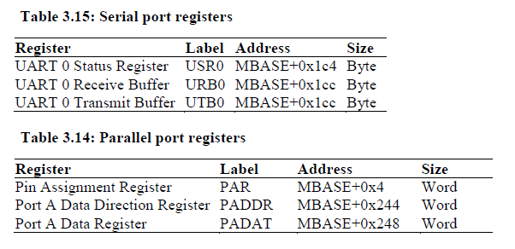
Serial & Parallel Registers
Serial and Parallel registers must be defined at the beginning of your program.
Define an address for MBASE, separate the rest of your program, then define the addresses of the registers you need as shown above.
Note the size of these registers! The serial port registers are Byte size and the parallel port registers are word size.
Refer to chapters 14 and 15 of the MCF5307 Coldfire User’s Manual for more information.

Slide 5
Serial Port Communication
Trap #15 should only be used Once in your program, to exit from your calculator’s menu back to the monitor
Modify your inchar and outchar subroutines to use serial registers to read in data and write to the monitor

Slide 6
Keyboard Input (inchar):
JanusROM automatically sets UART 0’s command register’s (UCR0) “receiver enable” bit to 0.
Loop until UART 0’s Status Register’s (USR0) “receiver ready” bit reads 0.
Read the data from UART 0’s buffer (URB0).
Monitor Output (outchar):
JanusROM automatically sets UART 0’s command register’s (UCR0) “transmitter enable” bit to 0.
Loop until UART 0’s Status Register’s (USR0) “transmitter ready” bit reads 0.
Read the data from UART 0’s buffer (UTB0).

Slide 7
Parallel Port Communication
Pin Assignment Register (PAR)
  Write $0000 to it to set Coldfire’s pins as a parallel port
Port A Data Direction Register (PADDR)
  Sets the direction of individual parallel port pins (0=input, 1=output)
Parallel port data register (PADAT)
  Use this to read the data from pins selected as inputs, and to write new values to the pins selected as outputs

Slide 8
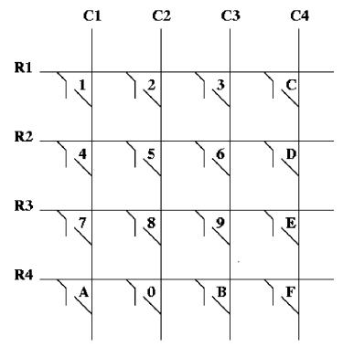
Parallel port: Reading Row Bitlines
Bit 4
Bit 5
Bit 6
Bit 7
Set PADDR’s bits to select the row lines [3:0] as input (data we wish to read) and the column lines [7:4] as output (we wish to set these high).
MOVE.W #$F0,D2
MOVE.W D2,PADDR
1 1 1 1
Bit 0
0
Bit 1
0
Set PADAT’s bits to set the column lines high.
MOVE.W D2,PADAT
A key press will short a column and row line together and drive the row line high
Reading the PADAT yields %11110100 or $F4
Bit 2
0->1
Bit 3
0

Slide 9
Parallel port: Reading Row Bitlines
Bit 4
Bit 5
Bit 6
Bit 7
Set PADDR’s bits to select the row lines [3:0] as output (data we wish to set high) and the column lines [7:4] as input (we wish to set these high).
MOVE.W #$0F,D2
MOVE.W D2,PADDR
0 0->1 0 0
Bit 0
1
Bit 1
1
Set PADAT’s bits to set the column lines high.
MOVE.W D2,PADAT
Reading the PADAT yields %00101111 or $2F
Use the data from the PADAT’s row and column reads to determine the pressed key.
Bit 2
1
Bit 3
1

Slide 10
Parallel Port Interfacing Pseudo-code
To determine which keypad key has been pressed:
Set column pins as output and row pins as input (PADDR)
Drive column pins high (PADAT)
read the PADAT and store it.
Repeat the above steps , set rows as inputs, columns as outputs, and drive the row pins high.
If the values read from the PADAT change, a key might have been pressed. Delay for debouncing.

Slide 11
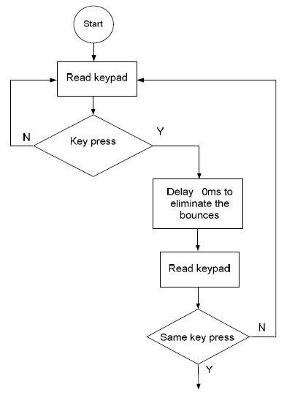
Debouncing
When pressed or released, the switches on the keypad will vibrate between an open and closed state rapidly for several milliseconds.
When your program detects a change, delay for a sufficient period of time (approx. 30ms) so that the keypad switch can settle down. Only then should you trust the value of the PADAT.
3

Slide 12
Delaying your Program
You will need to delay your program ~30ms for keypad debouncing and ~1ms after writing to the PADAT to let the parallel port pins settle.
Create a loop that will cycle N times with instructions that require M clock cycles to execute per iteration.
Coldfire’s clock runs at 90MHz / 2 (1 clock cycle = 22ns)
M x N = delay/22ns

Slide 13
Holding a Key Down
There are many ways to handle a user holding a key down:
Do not accept a key press until the user has released the keypad button.
Keep state information present in your subroutine: old_state and new_state, to track if a key was pressed in both this iteration of your keypad subroutine loop and the last one.
In your keypad loop:
If (new_state==1 and old_state==0), the user has just pressed the keypad. Store the value of the PADAT.
Else the user is holding the keypad down (new_state==1 && old_state == 1) or the keypad is not being pressed at all (new_state==0 && old_state == 0).
set old_state=new_state

Slide 14
Common issues:
Register sizes: serial port registers are byte size, parallel port registers are word size.
1ms and 30ms delays are estimates. Some Coldfire boards require more time for the pins/switches to settle. If your keypad is not responding/giving incorrect input/giving input without any key presses it may be due to insufficient delay times.
On some Coldfire boards reading the PADAT will give you incorrect values:
MOVE.W #$F0,D2
MOVE.W D2,PADAT ;PADAT stores $00F0
...
MOVE.W PADAT,D3 ;might read $F0F0!!
Mask the bits you don’t care about with the AND command:
AND.L $00FF,D3 ; eliminates bytes [3:1] of D3

Slide 15
Prelab Report
Program Description
  Objectives , Requirements, Assumptions and limitations
Program Design
  Describe the logical structure of your new subroutines (pseudo-code is sufficient)
Debugging and Testing Strategy
  Brief description
  Test plan: the subroutines you will you test and how you will approach testing them
  Test vectors: What inputs you will use to test your subroutines, and why you are using these specific inputs

Slide 16
Prelab Report
Due Date:
Monday February 27th, 11:59pm

Slide 17
Lab 3 Help Session:
Friday, Feb. 17th, 11:30am – 1:30pm
Lab 3 Practice Sessions:
Feb. 28th – March 1st
Section 1 2:30pm – 4:30pm
Section 2 9:30am – 11:30am

Slide 18
Lab 2&3 Demos
Demo Period (Lab 2 & 3, March 12 - 16)
  Be ready at your signed up time.
  Have the Completion Form printed and ready.
  Have your code list ready.
  The program is tested according to completion form.
  Questions are designed to ensure your understanding of the lab and to verify your ownership of the code.

Slide 19
Final report after demo
Dairy
  Brief but informative
  Milestones, problems and your solutions, design decisions.
  Record even if working outside the lab session
Post lab report
  Final Code (Mandatory: Proper code comments)
    Fully documented code listing (*.lst file), landscape if line wraps around.
  Discussion
    What was learned. How well your debugging/testing strategy worked. Possible improvement in your program.
NOTE: The post-lab report will cover Labs 2 and 3 combined, and must be submitted within 48 hours of the demo. Penalty for a late final report is 5% per day.

Slide 20
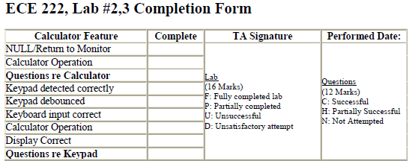
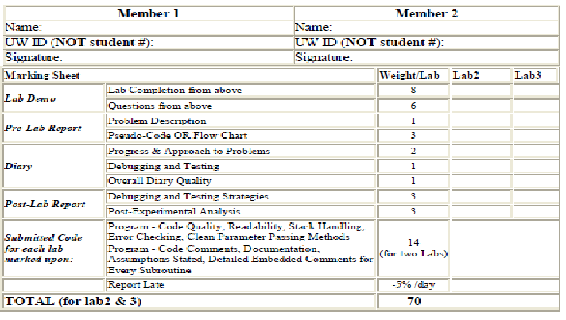

Slide 21
Lab 3 Help
Conor: cosulliv@uwaterloo.ca
Rajesh: rkm@uwaterloo.ca

